Slide 1

LA GENETICA E L’EPIGENETICA: QUALI DRIVERS PER IL FENOTIPO?
FRANCESCA GIROLAMI
SOC Cardiologia Pediatrica e della Transizione
AOU Meyer IRCCS- Firenze
francesca.girolami@meyer.it

Slide 2
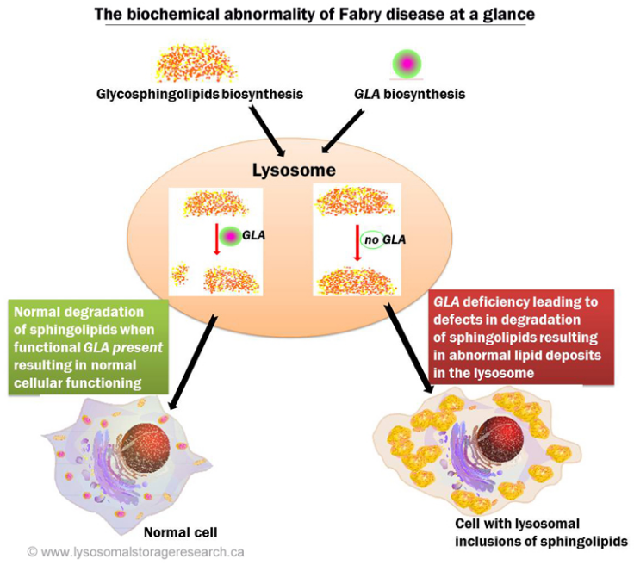
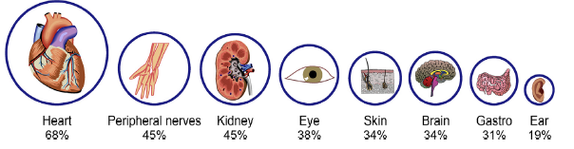
ANDERSON-FABRY DISEASE
Prevalence
1:40000 - 1 :117000
Ortiz A et al. Molec Gen and Metab 2018
Notes:
Malattia da accumulo lisosomiale ad ereditarietà x linked che coinvolge il metabolismo dei glicosfingolipidi ed è causata da deficit tot o parziale dellenzima alfagal..A codificato dal gene GLA. Tale gene mappa sul cromosoma X composto da 7 esoni. Riduzione dell enzima provoca accumulo di globotriasolceramide (GB3) responsabile delle modificazioni a catena in ambito cell e tissutale.

Slide 3
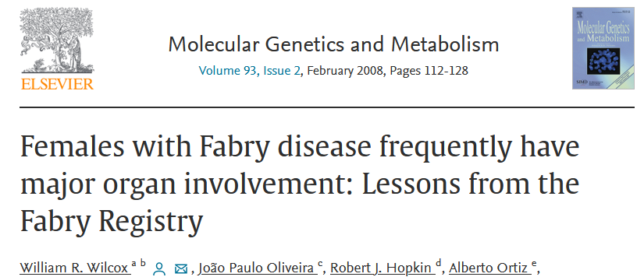
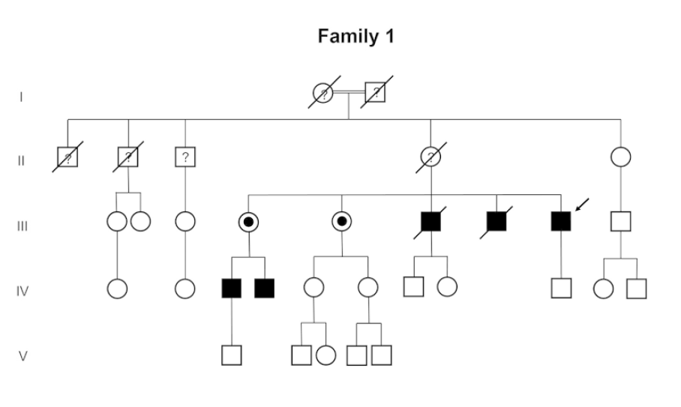
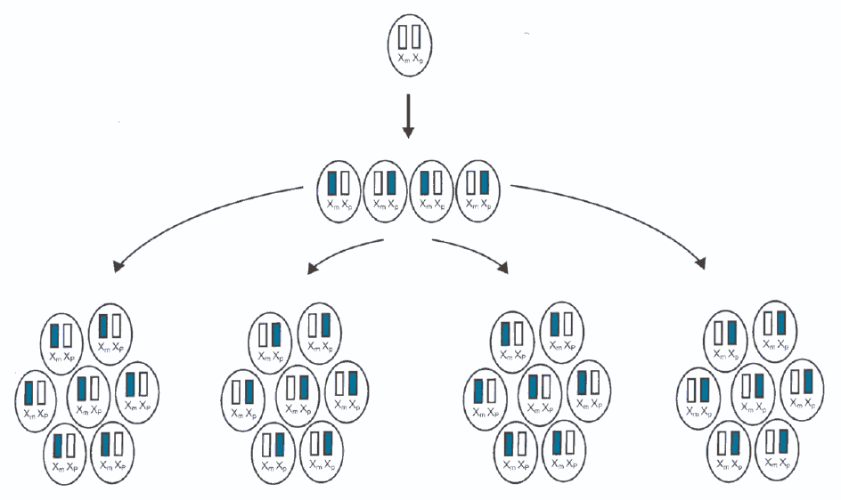
GENETIC BASIS
FD is trasmitted as an X-linked trait
Random X-chromosome inactivation
Wilcox WR et al. Molec Gen and Metab 2008
Notes:
FD is transmitted as an X-linked trait. Contrary to the
misconception that females will be marginally affected
given the X-chromosome linked inheritance pattern,
many heterozygotes will develop early symptoms and,
later on, vital organ involvement [24,26,182]. The use of
the term X-linked ‘recessive’ is therefore misleading and
should be discontinued and FD described as following
X-linked inheritance

Slide 4
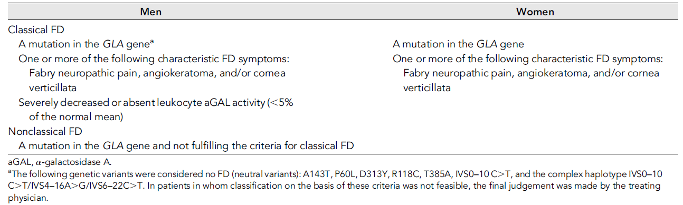


CRITERIA FOR PHENOTYPIC CLASSIFICATION
Arends M. Characterization of Classical and Nonclassical Fabry Disease: A Multicenter Study
Am Soc Nephrol , 2016

Slide 5
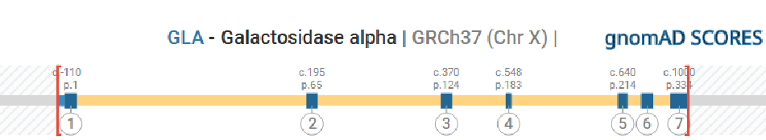
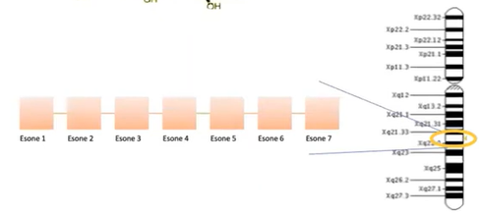

GLA GENE
Chr x
GLA
Xq22.1
12Kb, 7 exons
>1150 variants in GLA gene
HGMD Professional 2023.1 (Human Gene Mutation Database)
70% missense/ nonsense
14.3% small del
4.6% small ins/dup
3.8% large del (CNV)
4.5% splicing
7.4% others
Most of the pathogenic GLA mutations are private
Intra-familial phenotypic variability has been observed
Notes:
Lysosomal a-galactosidase A (EC 3.2.1.22) is coded by a
unique gene, GLA, whose locus is situated on the long
arm of chromosome X, in position Xq22. The GLA gene
consists of seven exons distributed over 12,436 base
pairs (bp). There is extensive allelic heterogeneity, but
no genetic locus heterogeneity.

Slide 6
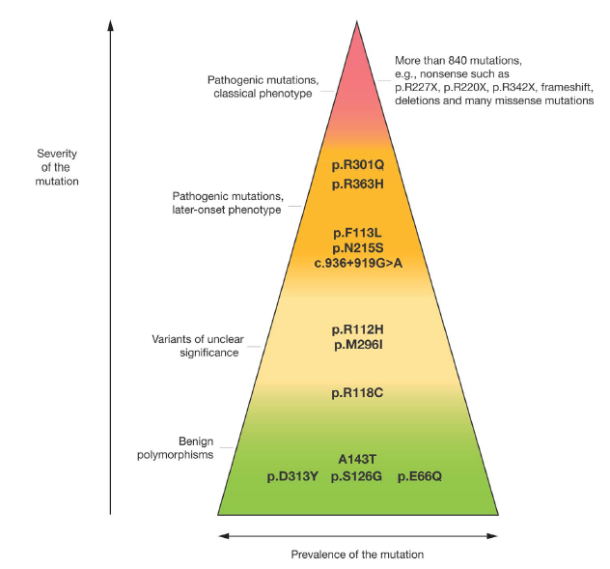
GENOTYPE-PHENOTYPE CORRELATIONS
CLASSICAL PHENOTYPE
absent alpha – GAL activity
Lyso Gb3 and Gb3
LATE ONSET PHENOTYPE
Reduced alpha-GAL activity
Lyso Gb3 and Gb3
VUS
NO DISEASE
Ortiz A et al. Molec Gen and Metab 2018
Notes:
Missense, nonsense, consensus splice site, cryptic splicing, and
frameshift mutations (small and large deletions and insertions) cause
Fabry disease (Fig. 1). In general, nonsense, consensus splice site, and
most frameshift mutations result in little or no α-Gal A enzyme activity,
and are associated with the classic phenotype. In contrast, a proportion
of the missense mutations and rare cryptic splicing mutations can encode
enzymes with residual α-Gal A activity, which may explain the
later-onset phenotypes. Some mutations, such as IVS4+919G>A (c.936+919G>A), very
common in Taiwan and southern China, appear to have reduced penetrance
[57].

Slide 7
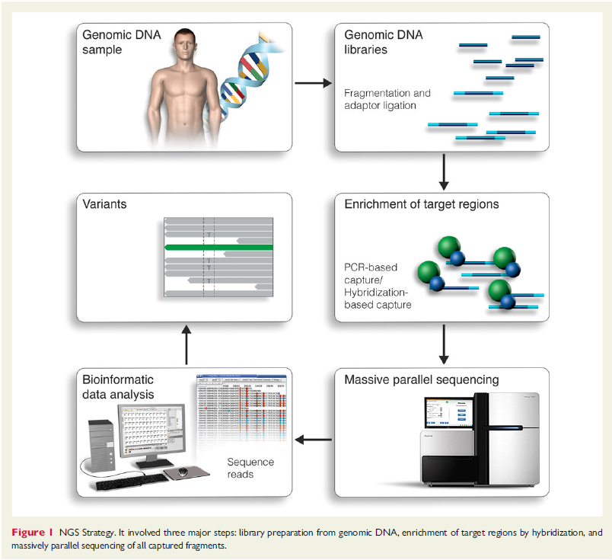




GENETIC TESTING STRATEGY
GENETIC TEST STRATEGY
Pre-test genetic
counseling
Genetic test
Post-test genetic
counseling
NGS Strategy
SANGER SEQUENCING
GLA
NGS
PANEL BASED APPROACH (Cardiomyopathy / Neuropathy * genes panel that includes GLA)
Modified by Ho CY. et al., 2015

Slide 8
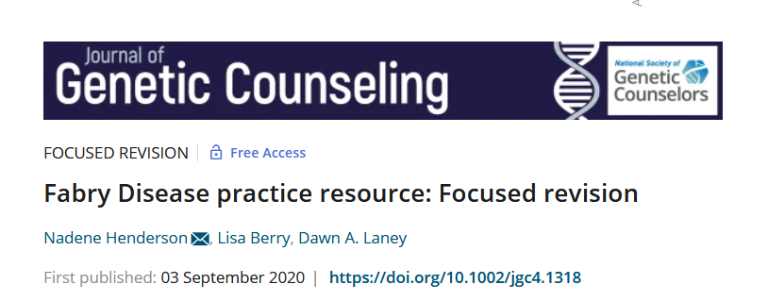
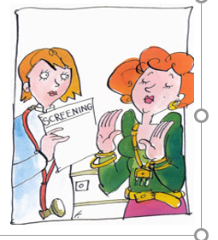
GENETIC SCREENING OF AT-RISK RELATIVES
Genetic counselling by multidisciplinary team in the context of a presymptomatic test is recommended
Pre-test /Post-test
The advantages and disadvantage of knowing a diagnosis well in advance of the appearance of symptoms
Regular follow-up of carriers to identify early signs and symptoms /THERAPIES?
Pre-conception or prenatal genetic counseling should be offered
Preimplantation genetic diagnosis
Notes:
Clinical and genetic screening of the at-risk members of families of
newly diagnosed patients is of critical importance, as additional family
members with Fabry disease may be identified from each individual
index patient. One pedigree review study found that, on average, there
were at least five family members diagnosed with Fabry disease following
the diagnosis of a proband [100]. These family members may be
diagnosed relatively early in the disease process. NBS programs based
on enzymatic assays for α-Gal A activity allow for the identification and
monitoring of individuals (mostly male) with Fabry disease mutations
from an early age [5,101], and permits identification of affected adults
in the family. Such programs have been initiated in some states in the
USA [20,102], several European countries [20,103,104], and Taiwan
[57,105]. Though the use of NBS for the identification of Fabry disease
Table 4
Recommended assessments and schedule for monitoring organ involvement in adult patients with Fabry disease.
Organ/system Assessment(s) Monitoring schedule
General Complete history and physical examination including family history and
evaluation of quality of life [94], gastrointestinal symptoms, work/study
performance, level of depression/anxiety
Every clinic visit
α-Gal A enzyme activity and GLA mutation analysis If not previously determined
Renal Glomerular filtration rate (measured GFR [preferred] or estimated
[eGFR] using appropriate formulae)
Annually if low risk, every 6 months if moderate risk, and every 3 months
if high to very high risk;a measured GFR only once yearly because of
complexity
Albuminuria (preferred, more sensitive) and/or proteinuria (24-h or spot
urine for total protein/creatinine and albumin/creatinine ratios)
Annually if low risk, every 6 months if moderate risk, and every 3 months
if high to very high risk
25 OH vitamin D As clinically indicated; vitamin D levels in late fall/early winter
Kidney biopsy As clinically indicated. Podocyte foot process effacement may precede
pathological albuminuria
Cardiac Blood pressure and cardiac rhythm Every clinic visit
ECG and echocardiography Annually, and as clinically indicated
48-h Holter monitoring to detect intermittent rhythm abnormalities;
[95] implantable loop recorder recommended for patients with
significant hypertrophic cardiomyopathy [96]
Annually, but may be assessed more or less frequently depending on age
and other risk factors; if arrhythmias detected, more frequent/detailed
rhythm surveillance should be instituted (schedule determined
individually)
Cardiac MRI with gadolinium If available, whenever there is evidence of clinical progression of disease
or regularly at an interval > 2 years
Cardiac MRI with T1 mapping Investigational tool, should be interpreted with caution
Brain natriuretic peptide At least annually for patients with cardiomyopathy or bradycardia
Cerebrovascular Brain MRI (TOF MRA at first assessment in male patients aged over 21
and female patients over 30, then according to the clinical picture)
Every 3 years and when clinically needed (e.g., presence of neurological
changes that could potentially relate to stroke) [37]
CT imaging In case of acute stroke and only if MRI is contraindicated due to cardiac
pacing
Peripheral nervous system Pain evaluation and history: pain measurement scale such as the
Neuropathic Pain Symptom Inventory or Brief Pain Inventory
Annually
Cold and heat intolerance, vibratory thresholds (quantitative sensory
testing, if available)
Annually (less frequently in older patients)
Autonomic symptom evaluation by orthostatic blood pressure Annually
Skin biopsy (for IENFD assessment, if available) Consider
ENT Audiometry [17] As required [17]
Pulmonary Spirometry, including response to bronchodilators, treadmill exercise
testing, oximetry, chest X-ray
Every 2 years or more frequently for clinical indications; [17] chest X-ray
according to clinical indications
Gastrointestinal Referral to gastroenterology specialist for endoscopic or radiographic
evaluation
If symptoms persist or worsen despite treatment
Overall glycolipid burden Plasma and urinary sediment lyso-GL-3, GL-3 At baseline and then annually (at the moment, this is for research
purposes only); biobanking of plasma/serum samples recommended if
feasible
Skeletal Bone dual-energy X-ray absorptiometry (DEXA) Consider
Ophthalmological Ophthalmological screening Ophthalmological screening as clinically indicated
Rationale and details for each organ system are provided in online Appendices A (renal), B (cardiac), C (peripheral nervous system), D (central nervous system), and E (involvement of
other organs). Baseline values should always be obtained; longer intervals between more complex organ assessments can be considered in asymptomatic female patients with a normal
initial evaluation and/or favorable X chromosome inactivation pattern.
CKD, chronic kidney disease; CT, computed tomography; ECG, electrocardiography; eGFR, estimated glomerular filtration rate; ENT, ear, nose, and throat; GFR, glomerular filtration rate;
IENFD, intra-epidermal nerve fiber density; MRI, magnetic resonance imaging; TOF MRA, time-of-flight magnetic resonance angiography (head and neck).
a Risk levels based on KDIGO 2012 chronic kidney disease classification scheme. Low risk, CKD Stage G1/2 A1; moderate risk, CKD stage G3a A1, G1/2 A2; high to very high risk CKD
Stage G4 or 5, G3b A1, G3 A3 [90]. See also online Appendix A, including Fig. 1S.
A. Ortiz et al. Molecular Genetics and Metabolism 123 (2018) 416–427
423
remains an ethical issue, several publications on patient experiences
with NBS for Fabry disease indicate that most patients would prefer to
be informed [106–108]. The most prevalent reasons include the elimination
of “feeling misunderstood” by parents, teachers, and physicians
– usually due to pain symptoms, the opportunity to begin early treatment
and prevent complications, and better reproductive decision
making [106,107]. However, female patients also indicated that having
the genetic knowledge resulted in a feeling of “being labeled as a patient”,
even though they were asymptomatic [106]; some patients, both
male and female, indicated that the early diagnosis also led to a loss of a
carefree life and increased worrying about the future [106]. Appropriate
genetic counseling should be provided for patients identified via
NBS [30]. However, counseling individuals (and families) who have a
missense VUS identified through such screening programs remains
challenging (see also Section 4 Diagnostic confirmation).

Slide 9

WHAT ARE THE POTENTIAL CONSEQUENCES OF GENETIC TESTING?
Ethical, psychological and pratical questions potential impact on reproduction, professional life
In addition….genetic testing can be an impact on family relationship
Contact with psychologist
Bouwman MG et al. Fabry patients' experiences with the timing of diagnosis relevant for the
discussion on newborn screening, Mol. Genet. Metab. 2013.
Notes:
Fabry disease has a profound emotional and physical impact on
affected individuals and their families. As appropriate, genetic counseling
sessions should also address the psychosocial issues that can arise following
a diagnosis of Fabry disease, such as anxiety concerning disease
progression, guilt related to passing the disease on to children, denial of
disease progression, and other strong emotions such as anger, grief,
blame, hopelessness, and impacts on self-esteem and self-identity.
Where applicable, economic, social, disability, employment, and life
insurance impacts should also be addressed/discussed Pre-conception or prenatal genetic counseling should be offered to
all male and female patients of reproductive age, discussing Fabry
disease's X-linked pattern of inheritance, availability of both prenatal
diagnosis using cultured amniocytes or chorionic villi for molecular
testing and preimplantation genetic diagnosis for selection of unaffected
embryos.

Slide 10
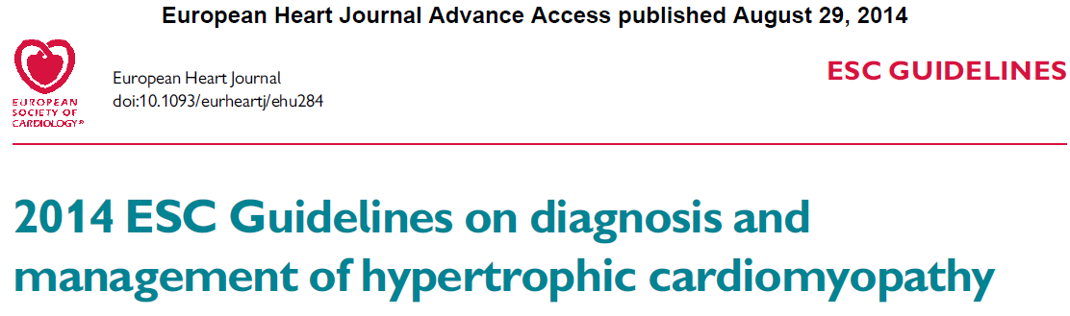
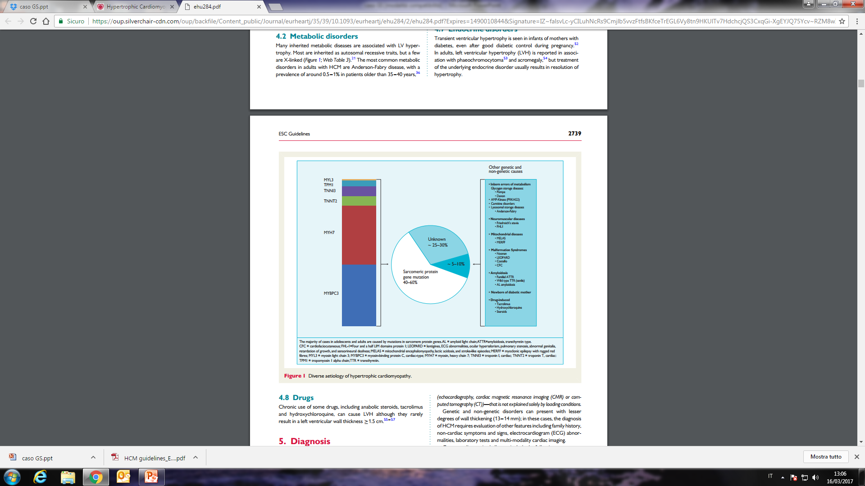
Glycogen storage disease:
Pompe
Danon
- AMP-Kinase (PRKAG2)
Lysosomal storage disease
- Anderson-Fabry
Notes:
La malattia di Anderson-Fabry va considerata nei pazienti con cardiomiopatia ipertrofica, a meno che non siano già state identificate mutazioni sarcomeriche, mitocondriali o sindromiche, causative. La malattia di Anderson-Fabry può essere sospettata nei pazienti con ipertrofia ventricolare sinistra, definita dallo spessore massimo di parete VS>12-<15 mm, senza altra causa definita, in presenza di sintomi e segni specifici della malattia

Slide 11
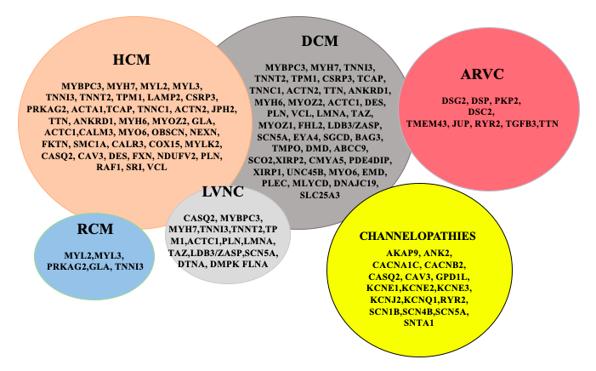
NGS CARDIO PANEL
Firenze, 9 settembre 2020
Selected genes associated to inherited cardiac conditions
OMIM, HGMD, PubMed (Wilde, A.A.M. et al N EHRA/HRS/APHRS/LAHRS. Expert Consensus Statement on the state of genetic testing for cardiac diseases. Europace 2022, 24, 1307–1367)

Slide 12
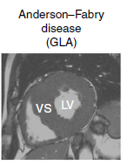
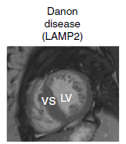
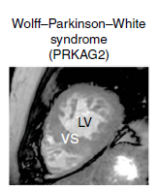
NON SARCOMERIC AETIOLOGIES ~3%
N= 3% (18/613 HCM patients)
Anderson-Fabry disease
Danon disease
Variants in GLA
GLA c.901C>T (p.Arg301*)
GLA c.37G>C (p.Ala13Pro)
GLA c.334C>T (p.Arg112Cys)
GLA c.644A>G (p.Asn215Ser)
GLA c.644A>G (p.Asn215Ser)
Variants in LAMP2
LAMP2 Large_deletion_het (chrX:119565127-119603074)
LAMP2 c.532C>T (p.Gln178*)
LAMP2 c.103_104del (p.Asp35Phefs*20)
LAMP2 c.755T>G (p.Ile252Ser)
Cardiac Amyloidosis
Wolff Parkinson White
Variants in TTR
TTR c.424G>A (p.Val124Ile)
TTR c.262A>T,(p.Ile88Leu)
TTR c.262A>T,(p.Ile88Leu)
TTR c.262A>T,(p.Ile88Leu)
TTR c.148G>A,(p.Val50Met)
Variants in PRKAG2
PRKAG2,c.905G>A,(p.Arg302Gln),p
PRKAG2,c.905G>A,(p.Arg302Gln),p
PRKAG2,c.959T>A,(p.Ile320Asn),p;
PRKAG2,c.709C>T,(p.Pro237Ser),p
Mazzarotto F, Girolami F al. Genetics in Med 2018

Slide 13
Case 1
A 70 year-old male with hypertrophy cardiomyopathy
Restrictive pattern
No extra-cardiac signs
Negative family history

Slide 14
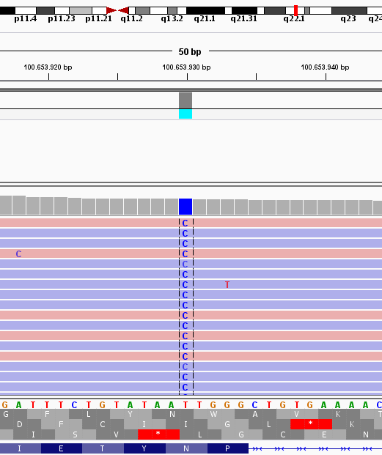
Case 1:GLA p.(Asn215Ser)
NGS gene panel for HCM
p.(Asn215 Ser) a later-onset cardiac phenotype
GLA
GLA
p.(Asn215Ser)
emizygous
pathogenic
70yrs
GLA
39yrs
Genetic testing
in minors
22 weeks
of pregnancy
Prenatal
genetic counseling
GLA
4yrs
IgV sofware: NGS data visualization
Germain DP et al Phenotypic characteristics of the p.Asn215Ser (p.N215S) GLA mutation in male and female patients with Fabry disease: A multicenter Fabry Registry study. Mol Genet Genomic Med.2018

Slide 15
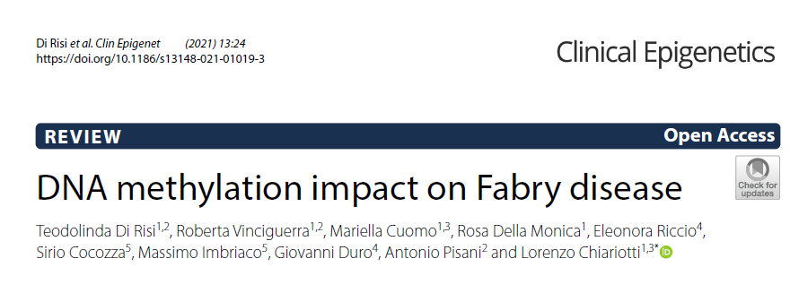
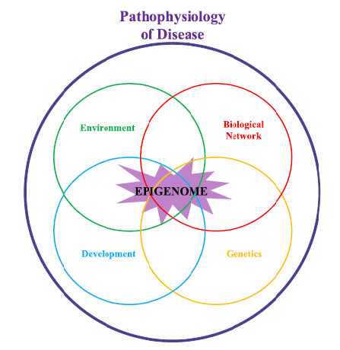
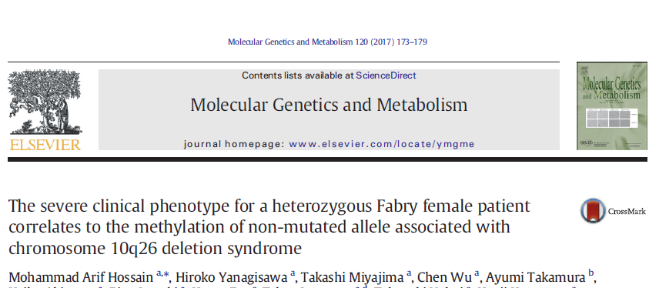
THE ROLE OF EPIGENETICS
May explain the clinical heterogeneity of FD
Atypical clinical presentation
Heterozygous female carriers of FD can exhibit a spectrum of phenotypes
Common mechanism:
DNA methylation, histone modifications, microRNAs
Hassan S et al Mol Genet and Metabol 2017

Slide 16
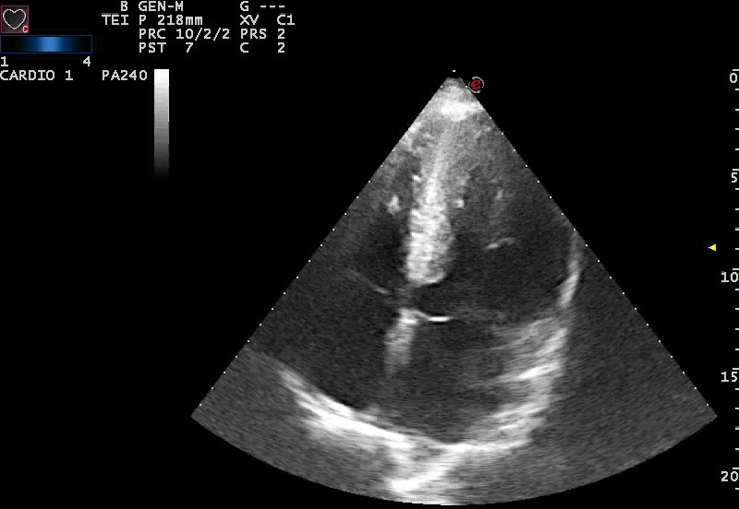
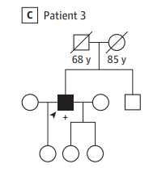
Case 2
A 65 year-old male with obstructive hypertrophy cardiomyopathy diagnosed during routine evaluation for hypertension
Mild renal insufficiency
Dyspnea
Negative family history

Slide 17
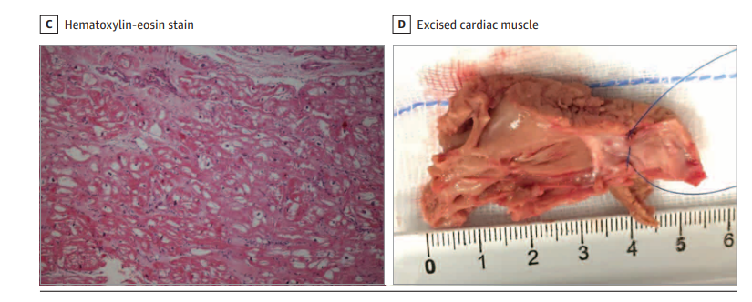
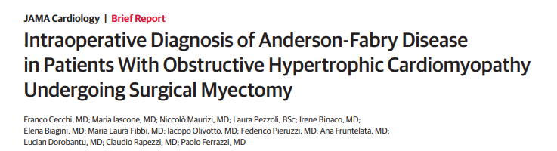
Case 2
Diagnosis of FD was suspected by the cardiac surgeon and confirmed by histological and genetic examinations
SURGICAL MYECTOMY
Notes:
s In this case series of 3 patients with hypertrophic cardiomyopathy, we found that Anderson-Fabry cardiomyopathy may mimic hypertrophic cardiomyopathy and present with severely symptomatic left ventricular outflow tract obstruction. The diagnosis was suspected by the cardiac surgeon and confirmed by histological and genetic examinations

Slide 18
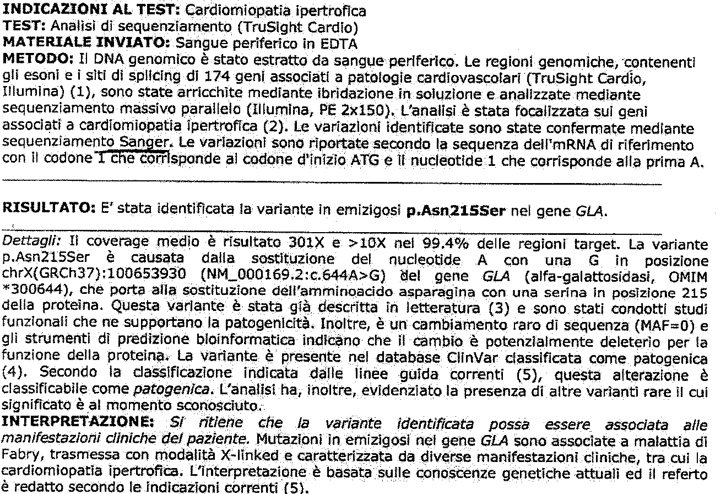
Case 2
Diagnosis of FD confirmed by genetic testing
Absent activity of alpha-gal A!
Notes:
s In this case series of 3 patients with hypertrophic cardiomyopathy, we found that Anderson-Fabry cardiomyopathy may mimic hypertrophic cardiomyopathy and present with severely symptomatic left ventricular outflow tract obstruction. The diagnosis was suspected by the cardiac surgeon and confirmed by histological and genetic examinations

Slide 19
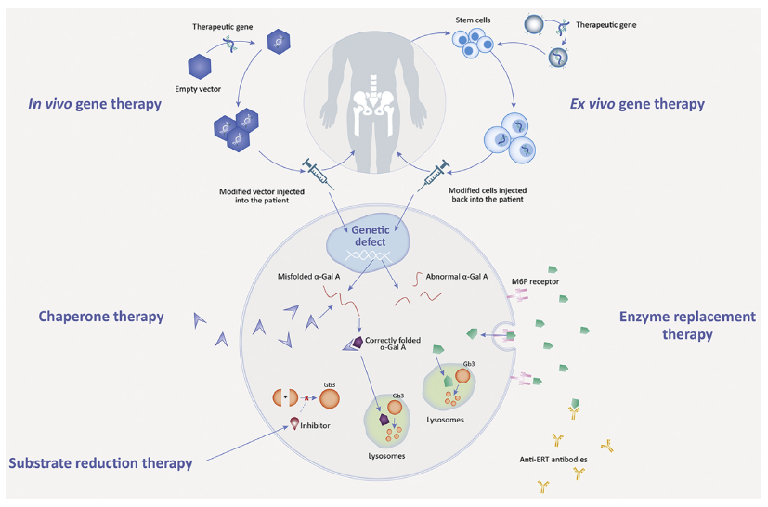
THERAPIES FOR FD
Pieroni M et al. JACC 2021

Slide 20
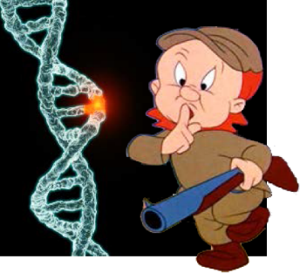

CONCLUSIONS
Genetic testing for:
Phenotipic classification
Genotype / phenotype correlations (classical vs atypical form)
Therapies (ERT, Chaperone, gene therapy)
Genetic counselling
Identify those at-risk before irreversible changes occur
Start therapy when it may be the most successful
Pre-conception or prenatal genetic counseling
Limitations: phenotypic heterogeneity
Epigenetics….
Multidisciplinary team in dedicated centres
FABRY MULTIDISCIPLINARY TEAM IN FLORENCE
Genetic insights can help improve precision and
improve outcomes!

